Slide 1

Introduction to Wireless Body Area Networks (WBANs)
Wireless Body Area Networks (WBANs) are wireless networks of wearable computing devices. These devices can continuously monitor vital parameters and body movements, making them valuable for healthcare and sports applications. Enabled by miniaturized sensors and low-power communication technologies, WBANs are paving the way for advanced healthcare monitoring and personalized fitness tracking.

Slide 2
IEEE Standards for WBANs
IEEE 802.15.6
Standard for Security
Quality of Service
Specifically addresses the unique challenges of WBANs, such as low power consumption. The purpose of the group is to establish a communication standard optimized for low-power in-body/on-body nodes to serve a variety of medical and non-medical applications. WBAN standard falls under the IEEE 802.15 task group 6, specified for short-range communication, extremely low power, applications requiring high quality of service (QoS), and data rate up to 10Mbps . It supports both physical and data link (MAC) mechanisms and conforms to the standard frequencies used worldwide for medical purposes
The WBAN standard defines three levels of security based on security properties, protection levels and frame formats. 1. Unsecured communication level: Here data are transmitted in unsecured frames. There will not be any mechanisms for data authentication, integrity, confidentiality or privacy protection. 2. Authentication level: Here data frames are transmitted in secured authentication without any encryption. The level does not support confidentiality or privacy. 3. Authentication and Encryption: This level has highest level of security. Here data frames are transmitted with authentication as well as encryption.
In WBANs, QoS ensures reliable and timely transmission of healthcare data.
- QoS ensures accurate delivery of medical data, avoiding errors in diagnosis and treatment.
- Reliable communication is essential for emergency response systems and telemedicine applications.

Slide 3
Advantages of WBANs
Real-time Monitoring: WBANs allow for continuous real-time monitoring of vital signs, providing immediate alerts for any abnormalities.
Low Power Consumption: Devices in WBANs are designed to operate on low power, prolonging battery life and reducing the need for frequent charging.
Enhanced Patient Care: WBANs enable remote patient management, improving access to healthcare and enhancing the quality of patient care.
Remote Patient Monitoring: WBAN enables continuous monitoring of patients' health parameters outside healthcare facilities. It allows early detection of anomalies and timely medical interventions.
Telemedicine: WBAN facilitates remote consultations between patients and healthcare providers. It enables doctors to monitor patients' conditions from a distance and provide guidance.
Sports and Fitness Tracking: Athletes use WBAN for monitoring performance metrics such as heart rate, temperature, and activity levels. It helps in optimizing training routines and preventing injuries.

Slide 4
Challenges in Implementing WBANs
Interference Issues
Power Consumption
Security Concerns
Coexistence with other wireless devices can lead to interference, affecting reliable data transmission within WBANs.
Wearable devices have constrained power sources, requiring efficient energy management..
Protecting sensitive health data is a major challenge, requiring robust encryption and authentication mechanisms in WBANs.
- The crowded spectrum in healthcare facilities poses challenges for ensuring signal integrity and data accuracy.
- Solutions include low-power hardware design, energy harvesting, and optimization algorithms.
- Ensuring secure communication and preventing unauthorized access are vital to maintaining patient privacy.
Recommendations for Addressing Challenges
- Collaborative efforts between stakeholders (industry, regulators, healthcare providers) to establish standards and best practices.
- Continued research and innovation in energy-efficient design, data security, and interoperability solutions.

Slide 5
Security and Privacy Concerns in WBANs
1
Data Security
2
Authentication
Ensuring encrypted transmission and secure storage of personal health information.
Data security is a major concern in WBAN technology because the data that is collected is often very sensitive. This data could be used to identify a person, track their location, or even be used to blackmail them
Verifying the identity of devices and users to prevent unauthorized access. WBAN devices struggle with complex authentication methods due to power, memory, and processing limitations. DoS attacks: Attackers can overwhelm the network with fake requests, preventing legitimate devices from connecting. – Sol – Mutual authentication
3
Privacy Protection
4
Interference Mitigation
WBANs collect highly sensitive health information like heart rate, blood pressure, and even brain activity, raising privacy concerns about unauthorized access and misuse. Implementing strategies to protect the privacy of individuals' health data. Weak security protocols can lead to data breaches, exposing sensitive information to unauthorized individuals or institutions.
With multiple WBANs operating in close proximity (e.g., hospitals), radio signals can overlap and interfere, causing data transmission errors and reduced network performance. Addressing potential interference from other wireless devices to maintain data integrity.

Slide 6



Comparison of WBANs with other wireless networks
Bandwidth
Power Consumption
Body Sensors
Data Security
WBANs require lower bandwidth compared to other wireless networks, as they transmit smaller amounts of data.
Other wireless networks are not optimized for body sensors, unlike WBANs designed specifically for this purpose.
WBANs prioritize data security, ensuring the confidentiality and integrity of sensitive health information.
WBANs have lower power consumption, making them ideal for battery-operated and energy-efficient devices.

Slide 7

Future of WBANs
As technology advances, the future of Wireless Body Area Networks (WBANs) looks promising. Innovations in miniaturization, power efficiency, and data processing will lead to seamless integration with healthcare systems. The potential for remote monitoring, early detection of health issues, and personalized medicine could revolutionize the healthcare industry.
Furthermore, the integration of artificial intelligence and machine learning algorithms will enhance the capabilities of WBANs, enabling real-time analysis and predictive diagnostics. These advancements will contribute to more efficient, cost-effective, and personalized healthcare solutions, ultimately improving patient outcomes and quality of life.

Slide 8
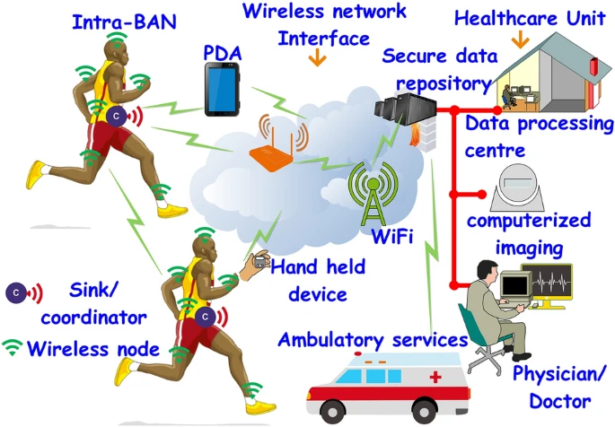
Real Life Use of WBANs
Athletic Performance Monitoring:
Athletes use WBANs to monitor heart rate, body temperature, and activity levels during marathons and training sessions.
The inter-BAN section may also have Personal Digital Assistant (PDA) and smart digital displays linked to the intra-BAN coordinator providing interactive user interfaces when accessing information for personal awareness. The data processing centre systems compute and analyze received information for health-related prognosis and decision support for medical professionals.

Slide 9
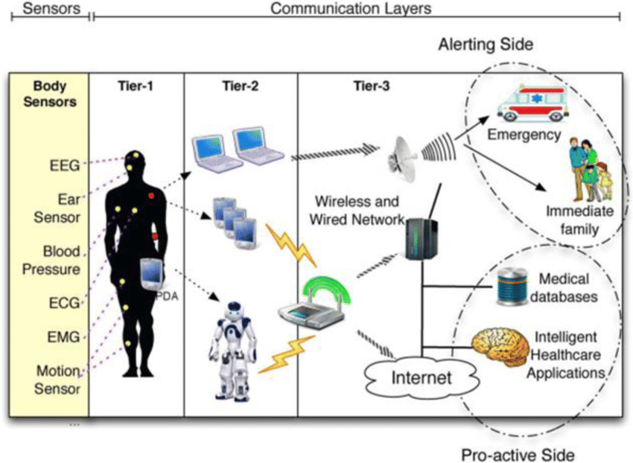
Remote Patient Monitoring
WBANs are used in hospitals to remotely monitor patient vital signs, reducing the need for constant bedside care.
WBANs can be used to monitor the health of patients remotely. This can be helpful for patients with chronic conditions, such as heart disease or diabetes. WBANs can also be used to monitor patients after surgery or during rehabilitation.
WBAN sensors can be worn by elderly individuals to monitor their movements and activity levels. These sensors can detect signs of potential falls, such as sudden changes in posture or imbalance, and send an alert to a designated emergency contact or healthcare provider.

Slide 10
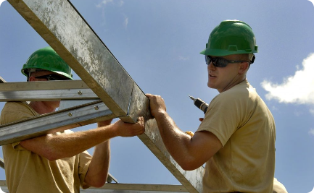

Industrial Safety
WBANs can be used to monitor the safety of workers in hazardous environments. For example, WBANs can be used to monitor workers' exposure to toxic chemicals or to track their location in case of an emergency. Construction workers use WBANs for real-time monitoring of vital signs and hazardous environmental conditions.
Animal Health Monitoring
WBAN sensors can be used to monitor the health of wild animals by tracking vital signs like heart rate, body temperature, and activity levels. This information can help researchers detect diseases, assess the overall health of animal populations, and identify potential threats.

Slide 11



Conclusion and key takeaways
Implementation Challenges
1
Interference, power consumption
Privacy Concerns
2
Data security, patient confidentiality
Future Prospects
3
Advancements, patient monitoring
As we conclude, it's clear that the implementation of Wireless Body Area Networks (WBANs) comes with challenges such as interference and power consumption. Privacy concerns, including data security and patient confidentiality, are significant. Looking ahead, the future prospects of WBANs are promising, with advancements in patient monitoring on the horizon.

Slide 12
REFERENCE :
https://link.springer.com/article/10.1007/s42452-020-04058-2
https://standards.ieee.org/ieee/802.15.6/5364/

